Slide 1
Giardia

Slide 2
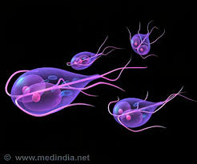

Slide 3
What is giardiasis?

Slide 4
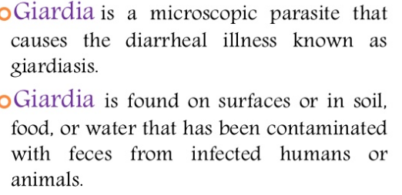

Slide 5
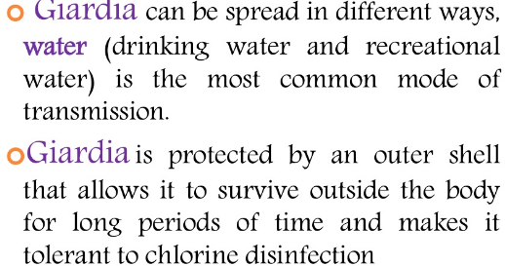

Slide 6
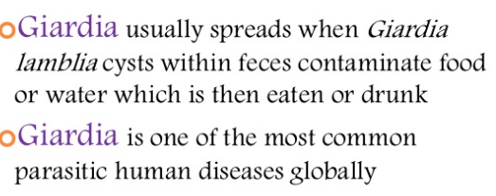

Slide 8
Swallowing Giardia picked up from surfaces (such as bathroom handles, changing tables, diaper pails, or toys) that contain feces (poop) from an infected person or animal Drinking water or using ice made from water sources where Giardia may live (for example, untreated or improperly treated water from lakes, streams, or wells) Swallowing water while swimming or playing in water where Giardia may live, especially in lakes, rivers, springs, ponds, and streams Eating uncooked food that contains Giardia organisms Having contact with someone who is ill with giardiasis Traveling to countries where giardiasis is common Anything that comes into contact with feces (poop) from infected humans or animals can become contaminated with the Giardia parasite.
People become infected when they swallow the parasite.

Slide 10
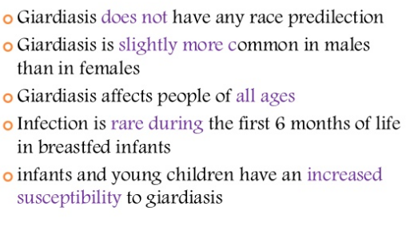

Slide 14
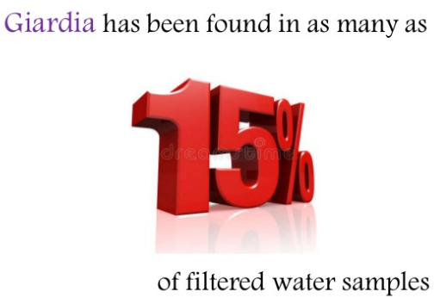

Slide 16
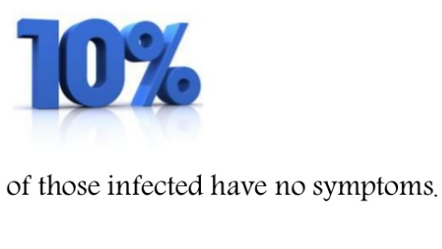

Slide 19
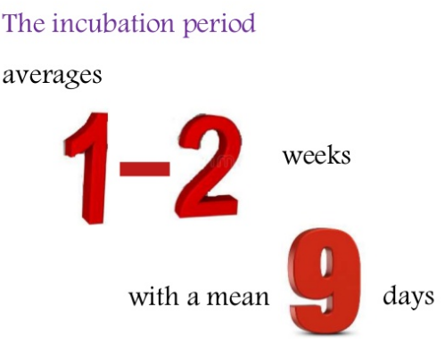

Slide 23
ccc

Slide 24
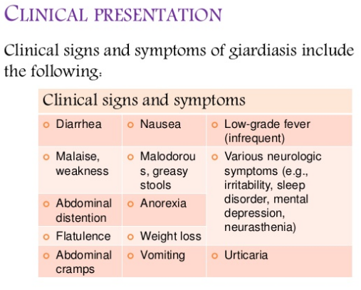

Slide 27
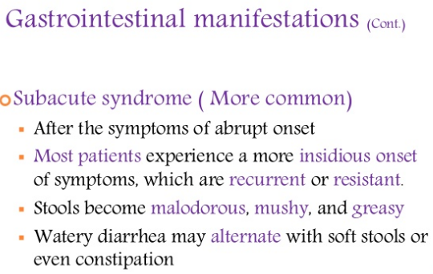

Slide 30
Symptom Percent
Diarrhea 64-100
Malaise. Weakness 72-97
Abdominal distension 42-97
Flatulence 35-97
Abdominal cramps 44-81
Nausea 14-79
Foul-smelling, greasy stools 15-79
Anorexia 41-73
Weight loss 53-73
Vomiting 14-35
Fever 0-28
Constipation 0-17

Slide 32
EXTRAINTESTINAL con
IRIDOCYCLITIS
COROIDITIS
RETINAL HEMORRHAGE
DYSPEPSIA

Slide 39
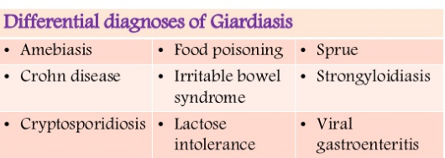

Slide 40
No effective and approved human vaccine against giardiasis is available

Slide 41
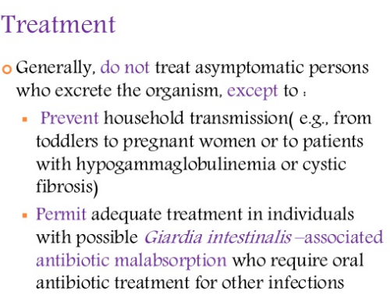

Slide 42
Recommended to cure symptoms and shorten the course of the disease. Effective treatment may reduce the risk of post-infectious complications and limit the spread of the infection.

Slide 43
Approved drugs consist of six classes of compounds, namely 5-nitroimidazoles (5-NIs) and benzimidazoles (BIs) derivatives, quinacrine, furazolidone, paromomycin, and nitazoxanide

Slide 44
Regardless of the drug and the regimen used, a 100% parasitological cure rate is rarely achieved

Slide 45
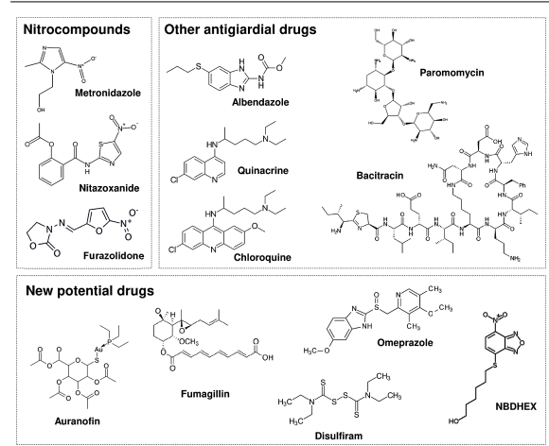

Slide 46
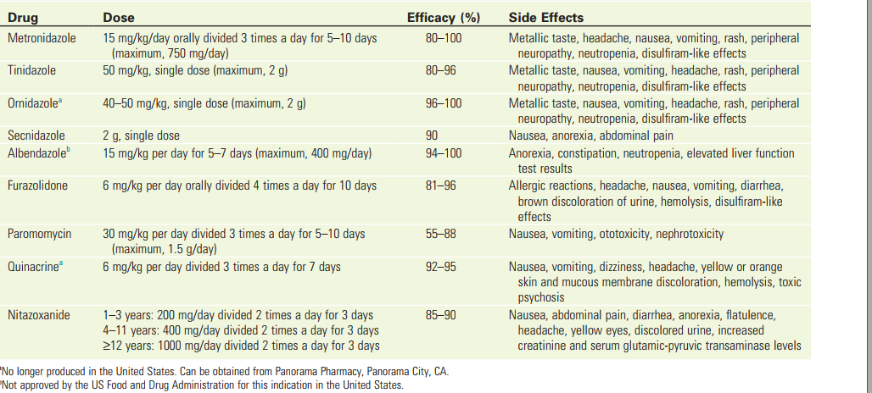

Slide 47
DRUG refractory
Resistance plus figure

Slide 48
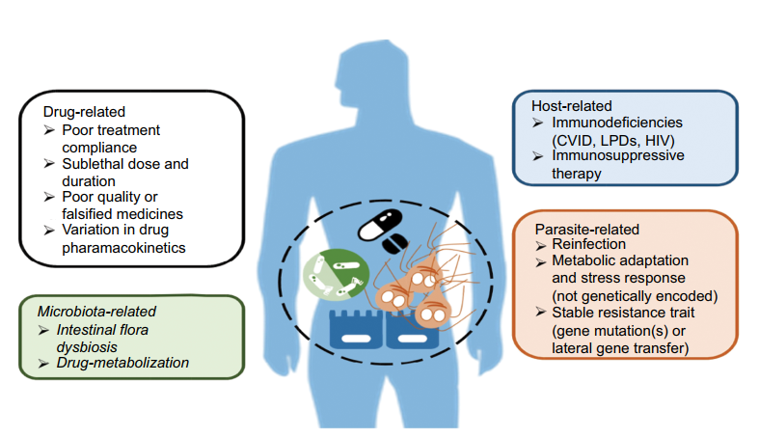

Slide 49
Drug RESISTANCE
DEFINITION
clinical drug-resistant giardiasis ; when stool samples remain positive for Giardia more than 1 week after treatment completion and when other reasons for treatment failure have been excluded and the risk of reinfection is very low

Slide 50
Treatment
REPEAT WITH PRIMARY DRUG
INCREASE DOSE ,DURATUION(5time mtz)
MULTIDRUG (quinacine+mtz or mtz+abz+-parmomycine
PROBIOTIC

Slide 51
bacitracin zinc Chloroquine mebendazole Pyrantel pamoate praziquantel
Nonclassic drug
Auranofin a gold complex, rapidly metabolized to the active form of gold, and currently approved by FDA to treat rheumatoid arthritis.
Fumagillin Disulfiram Omeprazole ( lansoprazole, pantoprazole, and rabeprazole (kill trophozoite)

Slide 52
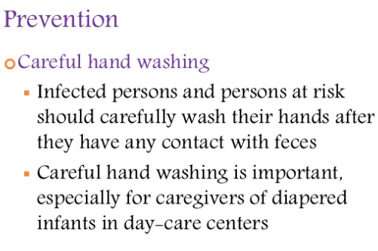

Slide 53
Blastocystis hominis

Slide 54
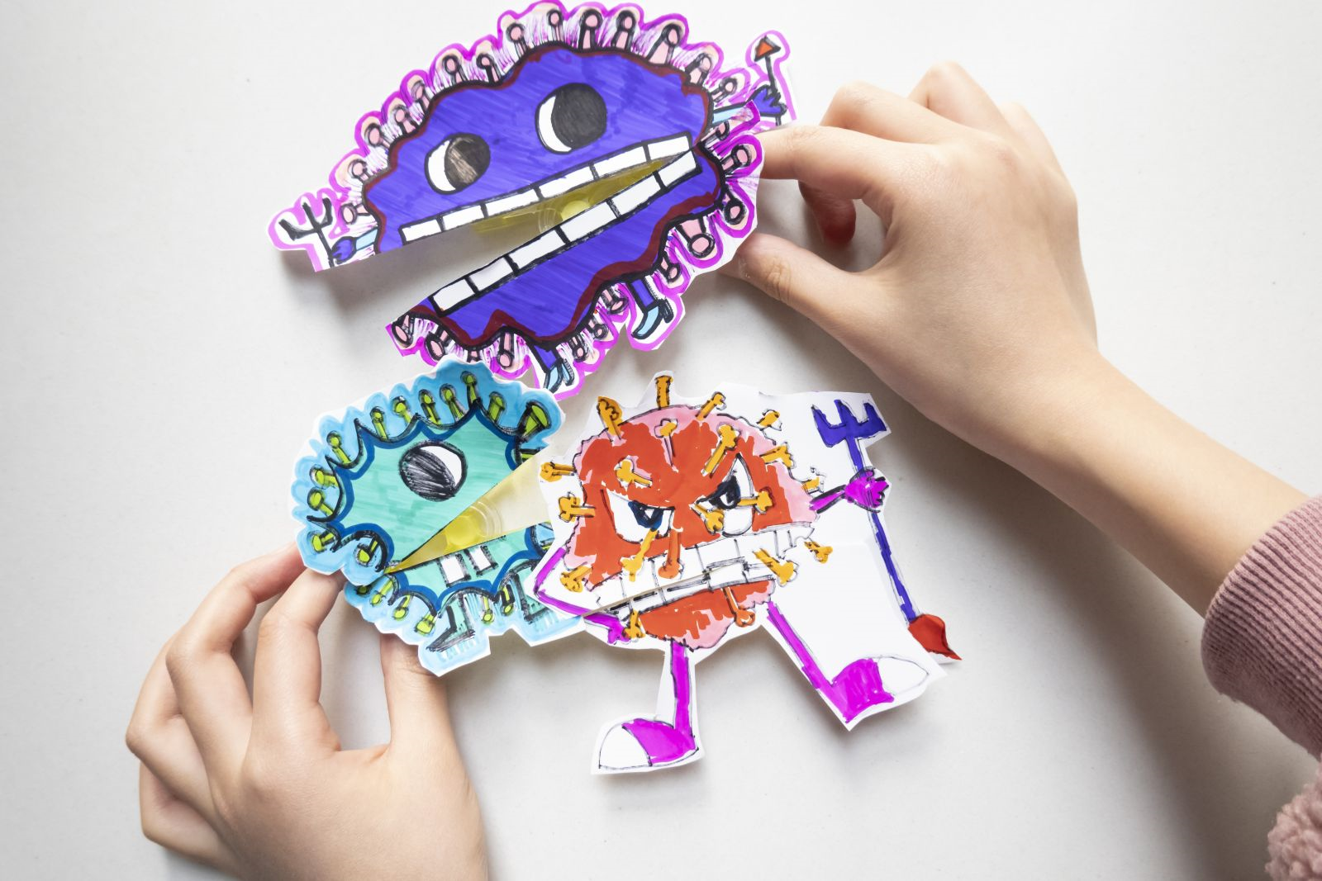
با تشکر فراوان از توجه شما

